Slide 1
Efficient Circuit Design with uDL
Steve Hoover

Slide 2
Outline
  Today’s design process and its challenges (the problem)
  μArch Design Language (μDL) (the solution)
    Overview
    Examples
  Closing thoughts

Slide 3
Models and Mappings
Verification
Models
Human
Tool
RTL
Verification
Abstract
Synthesis
Schematics
Layout
Notes:
Develop and maintain many models and many mappiings.
Tools validate Layout vs. sch. vs. RTL.
Functional and formal validation of RTL. Significant effort.

Slide 4
Tug-of-War
Verification
Models
RTL
Synthesis
Schematics
Layout
Notes:
Tug-of-war on the RTL between validation and implementation.

Slide 5
Early in the Project
Verification
Models
aRTL
Synthesis
Schematics
Layout
Notes:
Early in the project, the RTL is generally fairly abstract.
Though, it is a mix, driven by feasibility and validation risks and validation needs.

Slide 6
Late in the Project
Verification
Models
sRTL
Synthesis
Schematics
Layout
Notes:
By the end of the project, aRTL has been transformed into the sRTL which extensively reflects implementation details.

Slide 7
Problems
  Significant implementation driven churn in the sRTL, and therefore in the mappings to it. Changes require build and regression testing.
  Validation target becomes a more detailed model with greater potential for bugs and greater debug overhead.
  aRTL model is lost, so design reuse has a significant cost.
    uArch concepts are buried in implementation detail.
    Physical details in RTL are likely to change.
    Validation models that map to the RTL also reflect a great deal of physical detail.

Slide 8
Models and Mappings
uArch
Concept
Visualization
ISA/
Mem. Order
Spec
Coverage
Protocol
Models
Ref. Models
Perf.
Model
X-Actors
HLM
Queuing
Mdels
RTL
Synthesis
Schematics
Layout
Notes:
Many validation models with mappings to RTL that must be maintained as aRTL becomes sRTL.

Slide 9
Outline
  Today’s design process and its challenges (the problem)
  μArch Design Language (μDL) (the solution)
    Overview
    Examples
  Closing thoughts

Slide 10
μDL (μArch Design Language)
Verification
Models
uDL
Behavior
Verification
sRTL
Synthesis
Schematics
Layout
Notes:
We propose introducing a logical RTL model that is detached from its physical implementation and is maintained throughout the project.
We propose capabilities to map the aRTL to sRTL.
Mapping capabilities include isolated bits of sRTL with formal and functional validation path.
The mapping absorbs much of the implementation churn and mapping changes are lighter weight – they do not require regression simulations.
Functional validation against a simpler more stable target.

Slide 11
Mappings
uDL Behavioral Model
Physical
Partitioning
opcode = read
Encoding
01101
Pipeline
Staging

Slide 12
Refinement
head
tail

Slide 13
An Example
Logically: d = (a + b) - c
core[*]
(Chip)
finst[*]

Slide 14
An Example
Logically: d = (a + b) - c
core[*]
(Chip)
finst[*]
uDL Behavioral Code
>core[*] |finst[*]
d{255..0} = (a + b) - c
Notes:
Range restriction, which BTW applies only to valid instructions.

Slide 15
An Example
Logically: d = (a + b) - c
core[*]
(Chip)
Physically:
ren[*]
dep[*]
a
-
c
Enc
+
d
b

Slide 16
uDL Code
a
-
c
Enc
+
d
b
1: >core[*] |finst[*]
2: d{255..0} =
(a + b) - c
0
1
2
3
4
finst pipeline

Slide 17
uDL Code
a
-
c
Enc
+
d
b
1: >core[*] |finst[*]
2: d{255..0}
3: Beh
4: d = (a + b) - c
5: Phys
6: d = (a - c) + b
0
1
2
3
4
finst pipeline

Slide 18
uDL Code
a
-
c
Enc
+
d
b
1: >core[*] |finst[*]
2: d{255..0}
3: Beh
4: d = (a + b) - c
5: Phys
6: @1
7: a_minus_c = a - c
8: @3
9: d = a_minus_c + b
0
1
2
3
4
finst pipeline

Slide 19
uDL Code
a
-
c
Enc
+
d
b
1: ->core[*] |finst[*]
2: d{255..0}
3: Beh
4: d = (a + b) - c
5: Phys
6: -ren[finst]
7: @1
8: a_minus_c = a - c
9: -dep[finst]
10: @3
11: d = a_minus_c + b
0
1
2
3
4
finst pipeline

Slide 20
uDL Code
a
-
c
Enc
+
d
b
1: ->core[*] |finst[*]
2: d{255..0}
3: Beh
4: d = (a + b) - c
5: Phys
6: -ren[finst]
7: @1
8: a_minus_c’ = a - c
9: -dep[finst]
10: @3
11: d = ’a_minus_c + ’b
0
1
2
3
4
finst pipeline

Slide 21
uDL Code
a
-
c
Enc
+
d
b
1: ->core[*] |finst[*]
2: d{255..0}
3: Beh
4: d = (a + b) - c
5: Phys
6: -ren[finst]
7: @1
8: a_minus_c’ = a - ’c%binary
9: -dep[finst]
10: @3
11: d = ’a_minus_c + ’b
0
1
2
3
4
finst pipeline

Slide 22
Example sRTL
Module ren_sdef(…, a_minus_c_i2(8:0)) {
Signal c_i0(3:0),
Signal c_i1(3:0),
Signal a_i1(7:0),
Signal a_minus_c_i1(8:0),
…
a_minus_c_i1(8:0) = a_i1(7:0) – c_i1(3:0);
a_i1(7:0) = AFLOP(a_i0(7:0));
c_i0(3:0) = encoder(dec_c_i0(15:0));
c_i1(3:0) = AFLOP(c_i0(3:0));
a_minus_c_i2(8:0) = AFLOP(a_minus_c_i1(8:0));
}
Module dep_sdef(b_i2(7:0), a_minus_c_i2(8:0), …) {
Signal b_i3(7:0);
Signal a_minus_c_i3(8:0);
Signal d_i3(8:0);
Signal d_i4(7:0);
b_i3(7:0) = AFLOP(b_i2(7:0));
a_minus_c_i3(8:0) = AFLOP(a_minus_c_i3(8:0));
d_i3(8:0) = b_i3(7:0) + a_minus_c_i3(7:0);
d_i4(7:0) = AFLOP(d_i3(7:0));
Assert((d_i3(8) == 0b0) || !inst_valid_i3);
…
}
Signal a_minus_c_i2[3:0](7:0);
for (finst = 0; finst < 3; finst++) {
ren_sdef.ren[finst](…, a_minus_c_i2[finst](7:0));
dep_sdef.dep[finst](b_i2[finst](7:0), a_minus_c_i2[finst](7:0), …);
}
Notes:
> 2x total line count (implicit: signal declarations, flops, interfaces)
>10x behavioral line count
Much greater opportunity for bugs

Slide 23
Timing Abstraction
reg_data
inst
byp_data
a_operand
imm_data
+
2
3
mem_data
4
5
mem
1: |inst
2: @3
3: a_operand = select
4: imm_a : imm_data
5: byp_a : byp_data#+1
6: reg_a : reg_data#+2
7: mem_a : mem_data#mem+5
4
5
6
7
8
9

Slide 24
Timing Abstraction
reg_data
inst
byp_data
a_operand
imm_data
+
2
3
4
5
mem
mem_data
1: |inst
2: @4
3: a_operand = select
4: imm_a : imm_data
5: byp_a : byp_data#+1
6: reg_a : reg_data#+2
7: mem_a : mem_data#mem+5
4
5
6
7
8
9

Slide 25
Data Flow Model
  Pipelines are the conduits for “parcels” (which may pass through multiple pipelines)
  Validity:
    Invalid logic may not be consumed by valid logic (implicit assertions)
    A parcel (or sub-parcel) can be identified as invalid (by assigning its valid variable to false)
    Clock gating functions can be synthesized or verified
  “State” variables:
    are given reset values. Reset logic can be synthesized or validated in schematics.
    are retained (by default) over invalid cycles

Slide 26
Outline
  Today’s design process and its challenges (the problem)
  μArch Design Language (μDL) (the solution)
    Overview
    Examples
  Closing thoughts

Slide 27
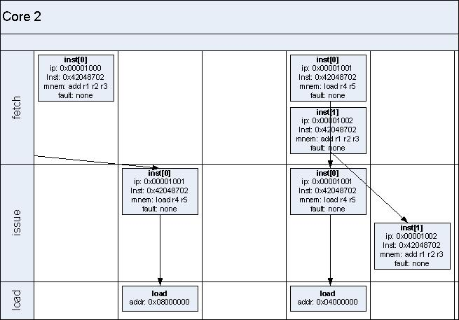
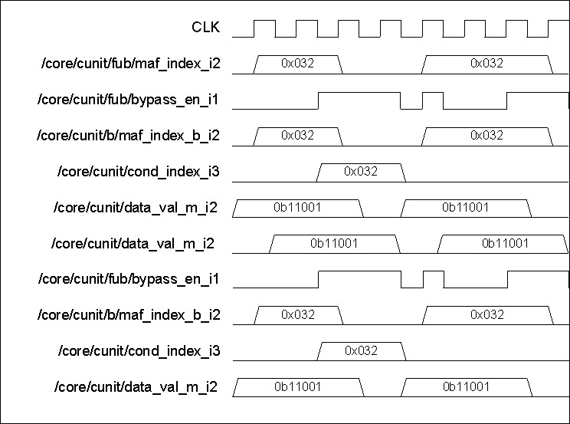
Solid Foundation for Further Advancements
  1) Visualization
uDL
RTL

Slide 28
Solid Foundation for Further Advancements
  Faster simulation
  Integrated performance modeling
  Hardware emulation
  Synthesis and FEV tools that understand the behavioral level
  Etc.

Slide 29
Summary
Verification
Models
Human
Tool
Abstract
uDL
Behavior
Verification
sRTL
Synthesis
Schematics
Layout
uDL is behavioral modeling plus mappings and refinements to sRTL.
Replaces RTL with less code. No complete extra model/language.
More abstract/stable val. target. Simpler maps to myriad val. models.
Safe physical changes without regression testing.

Slide 30
Acknowledgements
uDL is a culmination of many ideas that have existed within Intel and throughout our industry in various forms over many years. I thank all the free thinkers in our field!

Slide 31
Backup…

Slide 32
Model Build
for validation
uDL
VCS
aRTL
System Verilog
(aRTL)
for implementation
System Verilog
(sRTL)
FEV
Etc.
Logic
Synthesis

Slide 33
Correct by Construction?
Validation
Collateral
uDL
VCS
Behavior
System Verilog
(aRTL)
Simulation
Model
FEV
=?
VCS
Simulation
Model
System Verilog
(sRTL)
To sanity-check
“correctness-
by-construction”
FEV
Etc.
Logic
Synthesis
Notes:
Must validate aRTL sRTL gap.
Mappings are correct by construction, in theory.
FEV and functional validation flows for refinements.
sRTL simulation model with mapped validation ports.
Most validation at aRTL target. Sanity check against sRTL.

